Slide 1
UBL
FUTURE TENSE AND GOING TO
Dr. Hariyadi Raharjo
http://www.free-powerpoint-templates-design.com

Slide 2
Your Lecturer
Dr. Didik Hariyadi Raharjo, M.Pd.
081288111430

Slide 3
Lecture Agenda
01
Opening
In this phase, the lecturer will deliver the learning objectives and check the students' attendance.
02
Lecture and Discussion
In this phase, the lecturer will explain the learning material, give some examples and invite you to discuss the materials.
03
Evaluation
In this phase, the lecturer will check your understanding by giving some instructions and questions.
04
Closing
In this phase, the lecturer will invite you to make conclusions and provide additional explanations.

Slide 4

Are You Ready?
Just prepare yourself.

Slide 5

Future Tense Vs
Going to
There are two future forms used in most conversations: the future with "will" and the future with "going to." The main difference between the two forms is that "going to" is used for plans and intentions made before the moment of speaking, and the "will" to speak about the future at the moment of speaking.

Slide 6
Are you Ready?
Let’s learn about Simple Past.and Past Continuous

Slide 7

Future Tense and Going to Forms
Forms
Future Tense (will)
Form: Subject + will + verb 1
Examples:
I think I will go to that party next week.
The economy will get better soon.
Yes, I will marry you.
Future Tense (Negative)
Form: Subject + will + not (won't) + verb 1
Examples:
I think I will not go to that party next week
The economy will not get better soon.
Yes, I won’t marry you.
Future Tense (Interogative)
Form: Question word (optional) + will + subject
+ verb 1
Examples:
Will I go to that party next week?
When will the economy get better?
Will I marry you?

Slide 8
Future Tense and Going to Forms
Forms
Going to
Form: Subject + to be + going to + verb 1
Examples:
I am going to attend the meeting.
She's going to attend university and study to become a doctor.
We're going to make the presentation next week.
Going to (Negative)
Form: Subject + to be + not + going to + verb 1
Examples:
I am not going to attend the meeting.
She's not going to attend university and
study to become a doctor.
We're not going to make the presentation next week.
Going to (Interogative)
Form: Question word (optional)+ to be + subject
+ going to + verb 1?
Examples:
Am I going to attend the meeting?
Is she going to attend university and study to become a doctor?
Where am I going to stay?

Slide 9
Simple Past and Past Continuous Usage
USAGE
USAGE: Future Tense (will)
Use the future with will to talk about:
an event in the future that you have just decided to do
for predictions
for promises.
Examples:
I think I will go to that party next week. (decided to)
The economy will get better soon. (prediction)
Yes, I will marry you. (promise)
USAGE: Future Tense (going to)
The future with "going to" is used to express events you have already planned in the future and your intentions for the future. We sometimes also use the present continuous for planned events in the near
future. For something is likely to happen based on the evidence or experience you have
Examples:
She's going to attend university and study to become a doctor.
We're going to make the presentation next week.
I think it is going to rain - I just felt a drop. (based on the evidence)

Slide 10
Future Tense and Going to
SIGNAL WORDS
Signal Words: Future Tense (Will) vs. Going to
Signal words can help us to recognise which tense to use in a sentence. Below is a list of signal words
for the simple past and past continuous
tonight
tomorrow
the day after tomorrow
two later days
until
next month
next time
this afternoont
while
in a little while
after
if
when
before
as soon as

Slide 11
Do You Understand?
Let’s discusse together!.

Slide 12
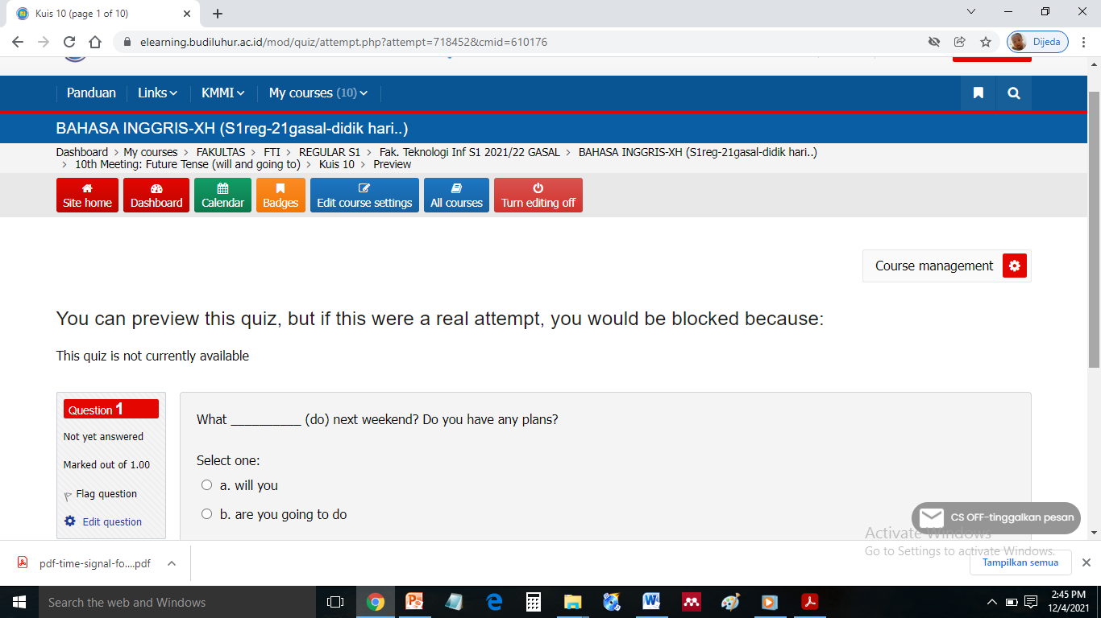
EVALUATION
Future Tense (will) Vs.
Going to
Directions: Choose the Right Answer!

Slide 13
Thank you
Good Luck

